Slide 1
wheel of the week
today
today
yesterday
yesterday
tomorrow
tomorrow
A couper au cutter après plastification
http://www.mysticlolly.fr

Slide 2
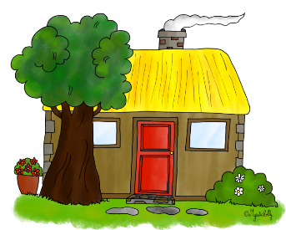
Roue à plastifier et découper
(semaine de 4 jours)
tuesday
Tuesday
Tuesday
wednesday
Wednesday
Wednesday
monday
Monday
Monday
thursday
Thursday
Thursday
sunday
Sunday
Sunday
friday
Friday
Friday
http://www.mysticlolly.fr
saturday
Saturday
Saturday

Slide 3
Roue à plastifier et découper
(semaine de 4,5 jours)
tuesday
Tuesday
Tuesday
wednesday
Wednesday
Wednesday
monday
Monday
Monday
thursday
Thursday
Thursday
sunday
Sunday
Sunday
friday
FRiday
Friday
http://www.mysticlolly.fr
saturday
Saturday
Saturday

