Slide 1
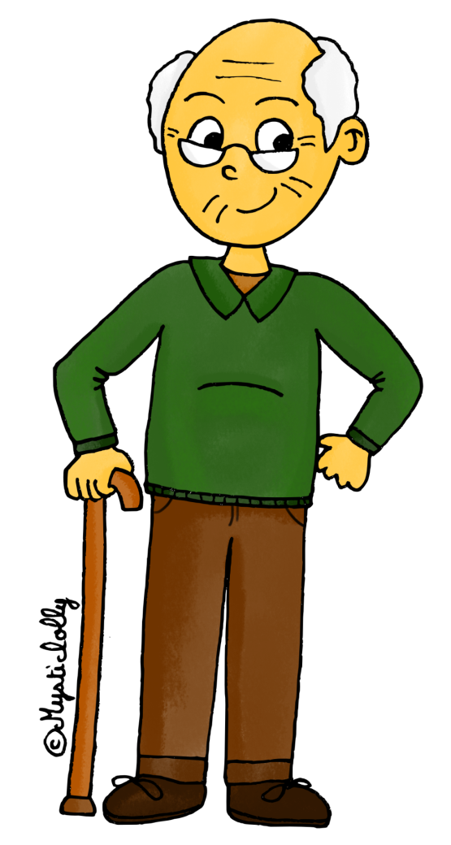
Start :
I have
Who has
the sister ?

Slide 2
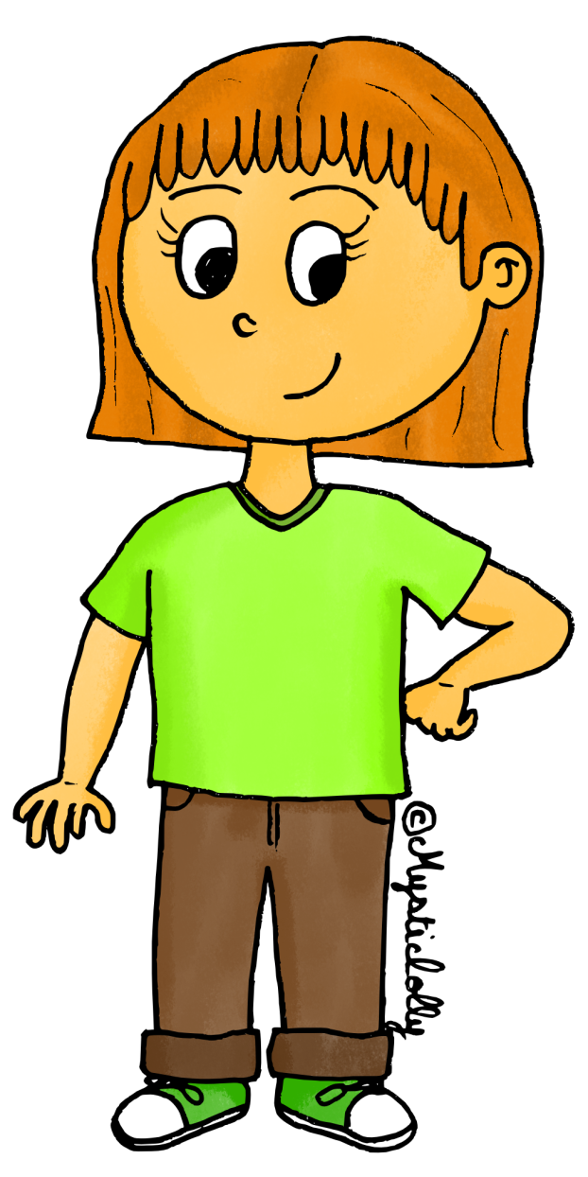
I have
Who has
the father?

Slide 3
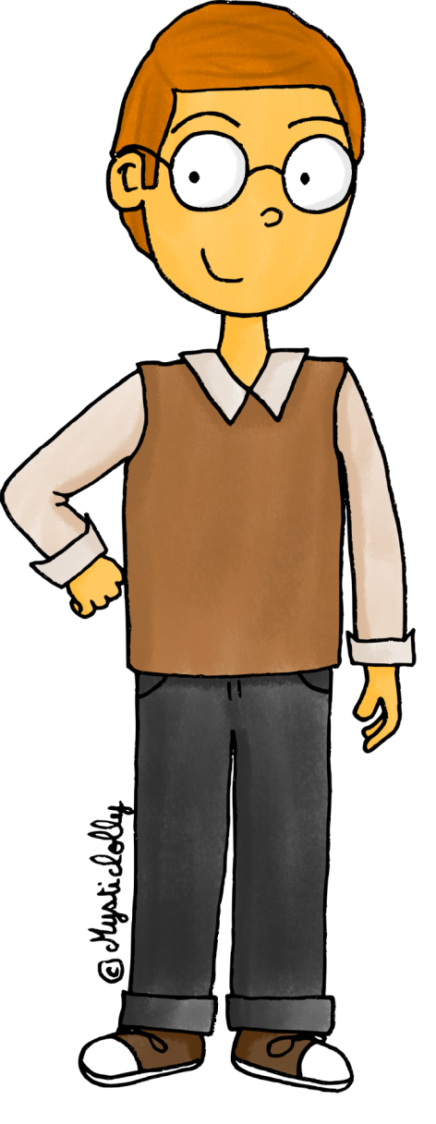
I have
Who has the grandmother?

Slide 4
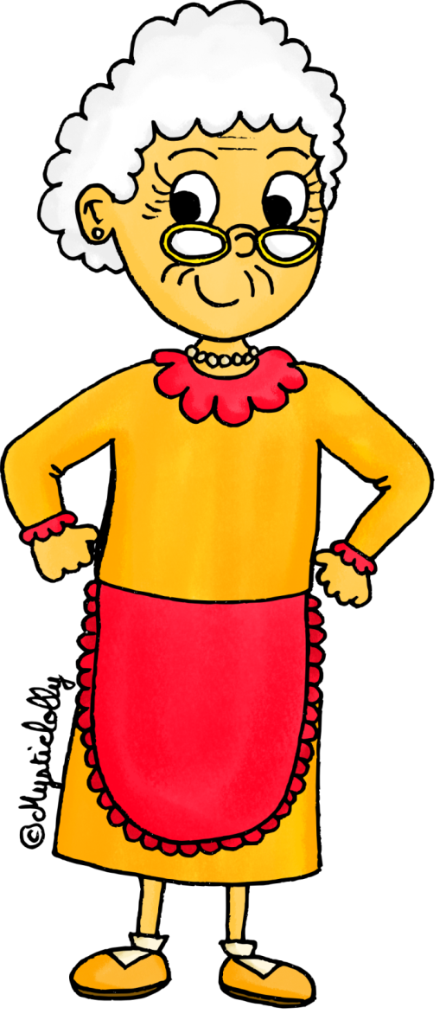
I have
Who has
the mother?

Slide 5
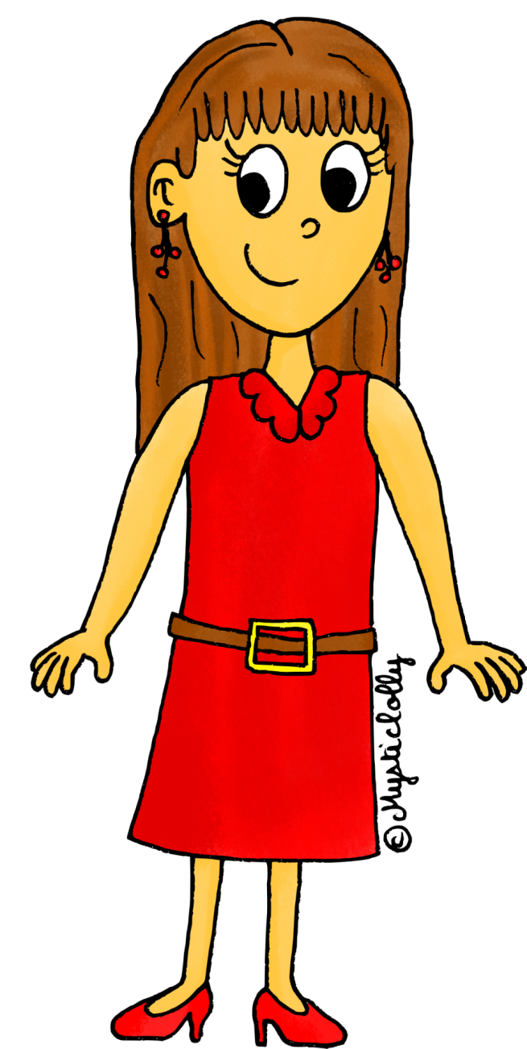
I have
Who has
the brother?

Slide 6
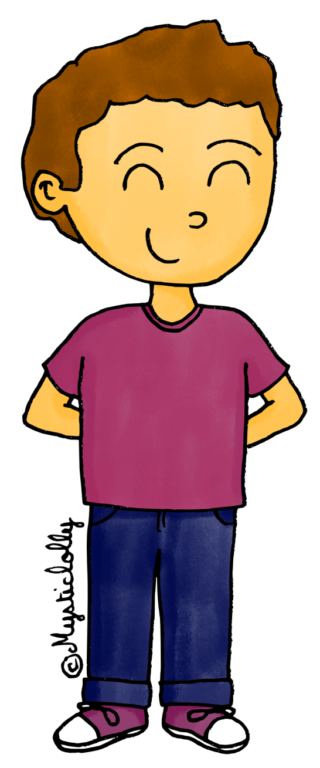
I have
Who has
the parents?

Slide 7


I have
Who has
the son?

Slide 8


I have
Who has
the children?

Slide 9


I have
Who has
the baby?

Slide 10
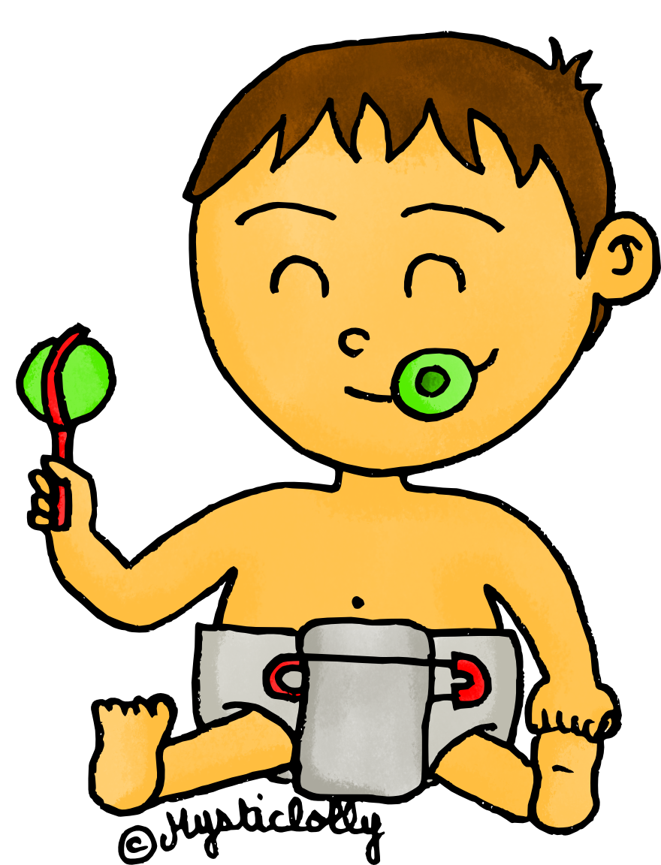
I have
Who has the daughter?

Slide 11


I have
Who has the grandparents?

Slide 12


I have
Who has the family ?

Slide 13






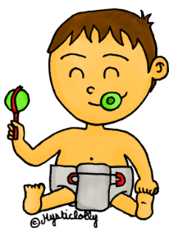
I have
The end !

